Slide 1
Basic Understanding of Electric Vehicle

Slide 2
Basics of Electrical Engineering
Ohms Law
Voltage
Current
Resistance
Voltage and current analogy with water

Slide 3
Ohm's Law
Ohms law is named after Mr. Ohm .defines the relation among Current ,Voltage and Resistance.
These are very basic electrical units that we work with.
These principles applied to both A.C and D.C
Alternating Current (Changes with respect with Time)
Direct Current (Constant )

Slide 4
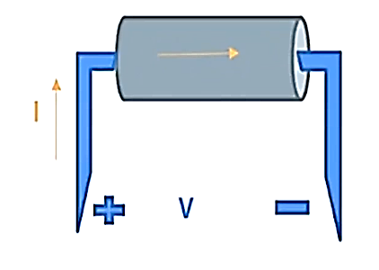
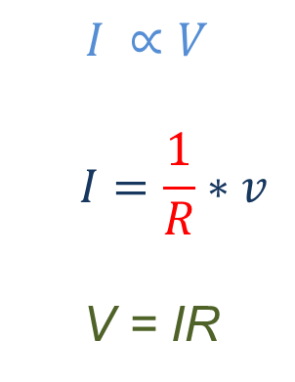
Ohm's Law
The current flowing through conductor is directly proportional to the potential
difference between its ends provided that the physical state such as temperature etc. remains constant.
V = Voltage
I = Current
R = Resistance
$$I ∝V$$
$$I=\frac{1}{R}∗v$$
V = IR

Slide 5
Voltage
Energy required to move a charge from one point to another
Current
The flow of charge in a conductor
Units : Volts (V)
Measured using Voltmeter
From Ohm's law V = IR
Units : Ampere (A)
Measured using Ammeter
From Ohm's law I = $\frac{v}{R}$
From Ohm's law I = 𝑣/𝑅

Slide 6
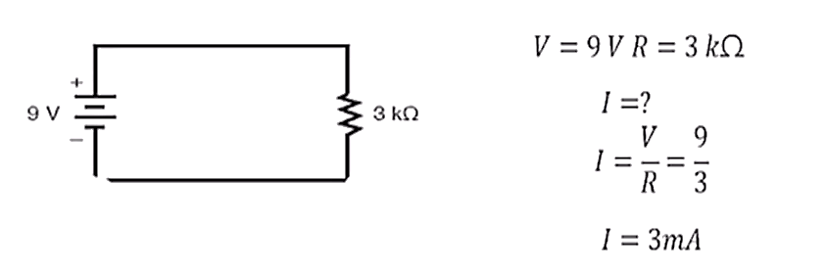
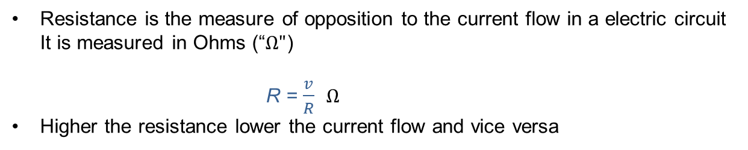
Resistance
Resistance is the measure of opposition to the current flow in a electric circuit
It is measured in Ohms (“$Ω"$)
R = $\frac{v}{R}$ $Ω$
Higher the resistance lower the current flow and vice versa

Slide 7
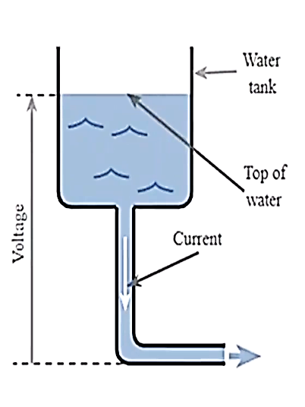
Voltage and Current Analogy with Water
Height of the water is analogous to the voltage,
The flow of water is analogous to the current,
The restriction of the water flow caused by the
pipe is analogous to the resistance

Slide 8
Thank You

